Slide 1
AI for Medicine
Lecture 10:
Support Vector Machines– Part I
February 17, 2021
Mohammad Hammoud
Carnegie Mellon University in Qatar

Slide 2
Today…
Last Wednesday’s Session:
  Molecular genetics and machine learning
Today’s Session:
  SVMs- Part I

Slide 3
Outline
SVM
Motivation
Background
Objective
Algorithm

Slide 4
Problems of Perceptron
Perceptrons exhibit various limitations in their ability to classify data
  The biggest problem is when data is not linearly separable (problem 1)
In this case, any line through the
examples will yield examples of both
classes on at least one of the sides!

Slide 5
Problems of Perceptron
Perceptrons exhibit various limitations in their ability to classify data
  The biggest problem is when data is not linearly separable (problem 1)
In principle, it is possible to transform
the examples into another space,
which makes them linearly separable

Slide 6
Problems of Perceptron
Perceptrons exhibit various limitations in their ability to classify data
  The biggest problem is when data is not linearly separable (problem 1)
However, doing so could lead to
overfitting (the situation where the
classifier works well on training data
but not on new data)

Slide 7
Problems of Perceptron
Perceptrons exhibit various limitations in their ability to classify data
  And even if the space is (or is made) linearly separable, there could be many hyperplanes, which are not all equally good (problem 2)
An acceptable hyperplane and the
new example indicated by “?” will be
classified as a square
?

Slide 8
Problems of Perceptron
Perceptrons exhibit various limitations in their ability to classify data
  And even if the space is (or is made) linearly separable, there could be many hyperplanes, which are not all equally good (problem 2)
Another acceptable hyperplane,
but the new example will now be
classified as a circle (although it
seems closer to squares!)
?

Slide 9
Problems of Perceptron
Perceptrons exhibit various limitations in their ability to classify data
  Yet, another problem is that perceptrons usually stop as soon as there are no misclassified examples (problem 3)
This hyperplane just managed to
accommodate the two squares
it touches before stopped

Slide 10
Problems of Perceptron
Perceptrons exhibit various limitations in their ability to classify data
  Yet, another problem is that perceptrons usually stop as soon as there are no misclassified examples (problem 3)
This hyperplane also just managed
to accommodate the two circles
it touches before stopped

Slide 11
Problems of Perceptron
Perceptrons exhibit various limitations in their ability to classify data
  Yet, another problem is that perceptrons usually stop as soon as there are no misclassified examples (problem 3)
If either of these hyperplanes
represents the final weight vector,
the weights will be biased toward
one of the classes

Slide 12
Problems of Perceptron
Perceptrons exhibit various limitations in their ability to classify data
  Yet, another problem is that perceptrons usually stop as soon as there are no misclassified examples (problem 3)
For example, if this hyperplane is the
one that the perceptron chooses, the
example indicated by “?” will be
classified as a circle
?

Slide 13
Problems of Perceptron
Perceptrons exhibit various limitations in their ability to classify data
  Yet, another problem is that perceptrons usually stop as soon as there are no misclassified examples (problem 3)
However, if this hyperplane is the one
that the perceptron selects, the
example indicated by “?” will be
classified as a square!
?

Slide 14
Support Vector Machines
A Support Vector Machine (SVM) is an improvement over a perceptron, whereby it addresses the three aforementioned problems
An SVM selects one particular
hyperplane (the green line in the
figure) that not only separates
the examples into two classes, but
does so in a way that maximizes
the margin (𝛾 in the figure), which is
the distance between the hyperplane
and the closest examples of the
training set
𝛾
𝛾
Support Vectors

Slide 15
Outline
SVM
Motivation
Background
Objective
Algorithm

Slide 16




Vectors
A vector can be visually represented as an arrow
A vector can also be represented as an ordered list or a tuple by starting from its tail and asking how far away is its head in the:
  Horizontal direction
  Vertical direction
Head
= $\left[\begin{aligned}4 \\ 3\end{aligned}\right]$
$$\vec{v}$$
$$\vec{v}$$
3
Or:
$\vec{v}$
= (4, 3)
Tail
4

Slide 17

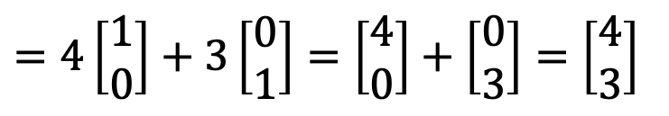







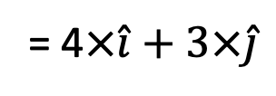


Unit Vectors
Any vector can also be represented as a sum of scaled up versions of unit vectors
It goes in the horizontal
direction only and has
length 1
= $\left[\begin{aligned}1 \\ 0\end{aligned}\right]$
$$\vec{v}$$
$$\hat{i}$$
$$\vec{v}$$
= $\left[\begin{aligned}4 \\ 3\end{aligned}\right]$
3
$$\hat{j}$$
= $\left[\begin{aligned}0 \\ 1\end{aligned}\right]$
It goes in the vertical
direction only and has
length 1
4
$$\hat{j}$$
$$\hat{i}$$
$$\vec{v}$$
= 4$×\hat{i}+3×\hat{j}$
$=4\left[\begin{aligned}1 \\ 0\end{aligned}\right]+3\left[\begin{aligned}0 \\ 1\end{aligned}\right]=\left[\begin{aligned}4 \\ 0\end{aligned}\right]+\left[\begin{aligned}0 \\ 3\end{aligned}\right]=\left[\begin{aligned}4 \\ 3\end{aligned}\right]$

Slide 18
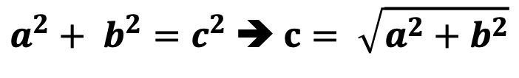

Vector Magnitude
How can we calculate the length (or magnitude) of a vector?
Pythagorean theorem:
c =
$$\vec{v}$$
$a^{2}+ b^{2}=c^{2}$➔ $c= \sqrt{a^{2}+b^{2}}$
b =
3
a =
4
Magnitude of the vector = $\left\|\vec{v}\right\|$ = $\sqrt{3^{2}+4^{2}}$ = $\sqrt{25}=5$
How can we keep vector, $\vec{v}$, pointing to the same direction, but change its magnitude to 1 (i.e., turn it into a unit vector)?

Slide 19
Vector Normalization
How can we construct a unit vector out of a given vector of any length?
Input:
Output:
Normalization
Vector of
any length
The vector with the same direction,
but with length 1

Slide 20


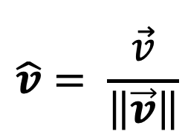

Vector Normalization
How can we construct a unit vector out of a given vector of any length?
Input:
Output:
Normalization:
$$\hat{v}= \frac{\vec{v}}{\left\|\vec{v}\right\|}$$
$$\vec{v}$$
$$\hat{v}$$
$$\frac{\vec{v}}{\left\|\vec{v}\right\|}$$

Slide 21


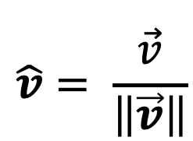


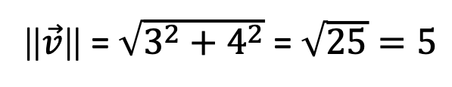

Vector Normalization
How can we construct a unit vector out of a given vector of any length?
$$\vec{v}$$
= $\left[\begin{aligned}4 \\ 3\end{aligned}\right]$
3
$$\hat{v}= \frac{\vec{v}}{\left\|\vec{v}\right\|}$$
= $\left[\begin{aligned}4/5 \\ 3/5\end{aligned}\right]$
$$\vec{v}$$
$$\hat{v}$$
4
Let us verify that its length is 1
‖$\vec{v}$‖ = $\sqrt{3^{2}+4^{2}}$ = $\sqrt{25}=5$

Slide 22
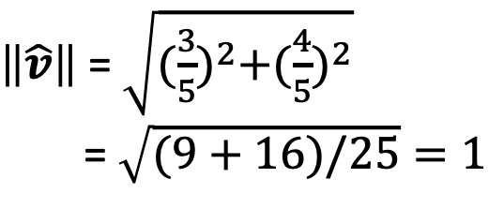
Vector Normalization
How can we construct a unit vector out of a given vector of any length?
$$\vec{v}$$
= $\left[\begin{aligned}4 \\ 3\end{aligned}\right]$
3
$$\hat{v}= \frac{\vec{v}}{\left\|\vec{v}\right\|}$$
= $\left[\begin{aligned}4/5 \\ 3/5\end{aligned}\right]$
$$\vec{v}$$
$$\hat{v}$$
4
$\left\|\hat{v}\right\|$ = $\sqrt{{(\frac{3}{5})}^{2}+{(\frac{4}{5})}^{2}}$
= $\sqrt{(9+16)/25}=1$
‖$\vec{v}$‖ = $\sqrt{3^{2}+4^{2}}$ = $\sqrt{25}=5$

Slide 23

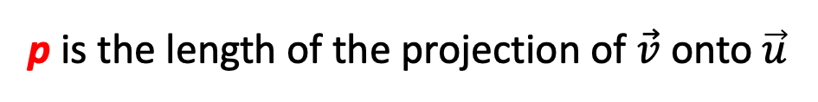

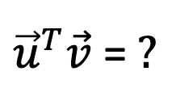


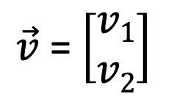

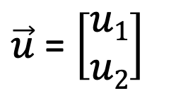



Vector Inner Product
Assume the following two vectors:
What is the inner product of $\vec{u}$ and $\vec{v}$?
Project $\vec{v}$ onto $\vec{u}$
$\vec{u}$ = $\left[\begin{aligned}u1 \\ u2\end{aligned}\right]$
$\vec{v}$ = $\left[\begin{aligned}v1 \\ v2\end{aligned}\right]$
$$v1$$
$\vec{v}$
$$u2$$
$$\vec{u}$$
p
$$v1$$
$$u1$$
${\vec{u}}^{T}\vec{v}$ = $?$
p is the length of the projection of $\vec{v}$ onto $\vec{u}$

Slide 24

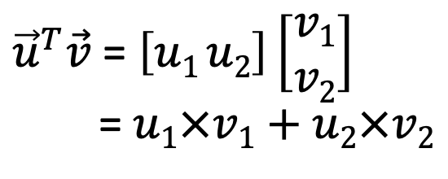
Vector Inner Product
Assume the following two vectors:
What is the inner product of $\vec{u}$ and $\vec{v}$?
Project $\vec{v}$ onto $\vec{u}$
$\vec{u}$ = $\left[\begin{aligned}u1 \\ u2\end{aligned}\right]$
$\vec{v}$ = $\left[\begin{aligned}v1 \\ v2\end{aligned}\right]$
$$v1$$
$\vec{v}$
$$u2$$
$$\vec{u}$$
p
$$v1$$
$$u1$$
${\vec{u}}^{T}\vec{v}$ = $p ×\left\|\vec{u}\right\|$
≣
${\vec{u}}^{T}\vec{v}$ = $\left[u1 u2\right]\left[\begin{aligned}v1 \\ v2\end{aligned}\right]$
= $u1×v1+$ $u2×v2$
p is the length of the projection of $\vec{v}$ onto $\vec{u}$
Can be signed

Slide 25


Vector Inner Product
Assume the following two vectors:
What is the inner product of $\vec{u}$ and $\vec{v}$?
$\vec{u}$ = $\left[\begin{aligned}u1 \\ u2\end{aligned}\right]$
$\vec{v}$ = $\left[\begin{aligned}v1 \\ v2\end{aligned}\right]$
Project $\vec{v}$ onto $\vec{u}$
$$\vec{u}$$
$\vec{v}$
p
$$u1$$
${\vec{u}}^{T}\vec{v}$ = $p ×\left\|\vec{u}\right\|$
≣
${\vec{u}}^{T}\vec{v}$ = $\left[u1 u2\right]\left[\begin{aligned}v1 \\ v2\end{aligned}\right]$
= $u1×v1+$ $u2×v2$
p is negative here

Slide 26
Outline
SVM
Motivation
Background
Objective
Algorithm

Slide 27
What is the Objective of SVM?
The objective of an SVM is to select a hyperplane w.x + b = 0 that maximizes the distance, 𝛾, between the hyperplane and any example in the training set
Intuitively, we are more certain of
the class of examples that are far
from the separating hyperplane
than we are of examples near to
that hyperplane
𝛾
𝛾
w.x + b = 0

Slide 28
What is the Objective of SVM?
The objective of an SVM is to select a hyperplane w.x + b = 0 that maximizes the distance, 𝛾, between the hyperplane and any example in the training set
Thus, it is desirable that all the
training examples be as far from
the hyperplane as possible
(but on the correct side of that
hyperplane, of course!)
𝛾
𝛾
w.x + b = 0

Slide 29
What is the Objective of SVM?
More formally, the goal of any SVM can be stated as follows:
Given a training set (x¹, y¹), (x², y²), . . . , (x^{n}, y^{n}), maximize 𝛾 (by varying w and b) subject to the constraint that for all i = 1, 2, . . . , n,
y^{i}(w.x^{i} + b) ≥ 𝛾
Notice that y^{i}, which must be +1 or −1, determines which side of the hyperplane the point x^{i} must be on, so the ≥ relationship to 𝛾 is always correct!

Slide 30
What is the Objective of SVM?
More formally, the goal of any SVM can be stated as follows:
Given a training set (x¹, y¹), (x², y²), . . . , (x^{n}, y^{n}), maximize 𝛾 (by varying w and b) subject to the constraint that for all i = 1, 2, . . . , n,
w.x^{i} + b ≥ 𝛾 if y^{i} = +1
w.x^{i} + b ≤ -𝛾 if y^{i} = −1
y^{i}(w.x^{i} + b) ≥ 𝛾
≣
But, by increasing w and b, we can always allow a larger value of 𝛾 (e.g., If we replace w by 2w and b by 2b, then for all i, y^{i}((2w).x^{i} + 2b) ≥ 2𝛾

Slide 31
What is the Objective of SVM?
More formally, the goal of any SVM can be stated as follows:
Given a training set (x¹, y¹), (x², y²), . . . , (x^{n}, y^{n}), maximize 𝛾 (by varying w and b) subject to the constraint that for all i = 1, 2, . . . , n,
w.x^{i} + b ≥ 𝛾 if y^{i} = +1
w.x^{i} + b ≤ -𝛾 if y^{i} = −1
y^{i}(w.x^{i} + b) ≥ 𝛾
≣
Hence, 2w and 2b are always better than w and b, so there is no best choice and no maximum 𝛾!

Slide 32

The Objective of SVM
How can we solve this problem?
  By normalizing the weight vector w (i.e., $w/{∥w∥}$), thus making it a unit vector
  Consequently, the parallel hyperplanes that just touch the support vectors can be described by the equations w.x+b = +1 and w.x+b = −1

Slide 33

The Objective of SVM
How can we solve this problem?
  By normalizing the weight vector w (i.e., $w/{∥w∥}$), thus making it a unit vector
x¹
Consider one of the support vectors,
(say, x², in the figure) and let x¹ be
the projection of x² to the upper
hyperplane
x²
𝛾
w.x + b = +1
𝛾
w.x + b = -1
w.x + b = 0

Slide 34
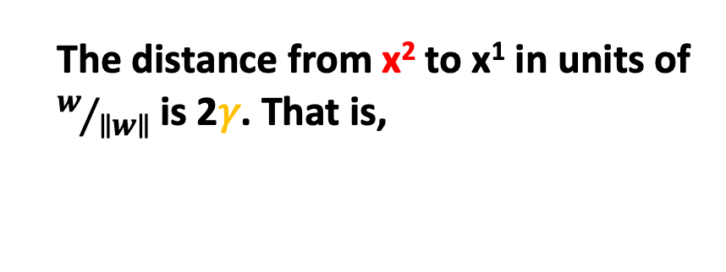
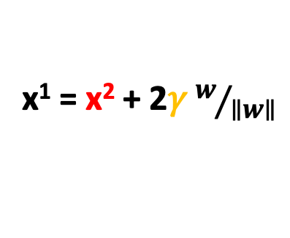
The Objective of SVM
How can we solve this problem?
  By normalizing the weight vector w (i.e., $w/{∥w∥}$), thus making it a unit vector
x¹
The distance from x² to x¹ in units of
$w/{∥w∥}$is 2𝛾. That is,
x²
x¹ = x² + 2𝛾 $w/{∥w∥}$
𝛾
w.x + b = +1
𝛾
w.x + b = -1
w.x + b = 0

Slide 35
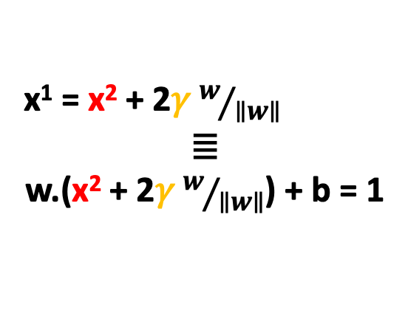
The Objective of SVM
How can we solve this problem?
  By normalizing the weight vector w (i.e., $w/{∥w∥}$), thus making it a unit vector
x¹
Since x¹ is on the hyperplane
defined by w.x + b = +1, we know that
w.x¹ + b = 1. If we substitute for x¹:
x²
x¹ = x² + 2𝛾 $w/{∥w∥}$
≣
w.(x² + 2𝛾 $w/{∥w∥}$) + b = 1
𝛾
w.x + b = +1
𝛾
w.x + b = -1
w.x + b = 0

Slide 36
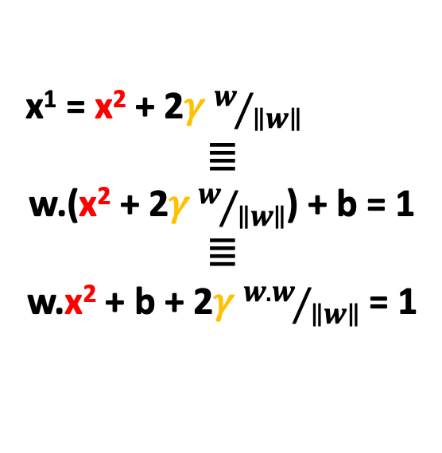
The Objective of SVM
How can we solve this problem?
  By normalizing the weight vector w (i.e., $w/{∥w∥}$), thus making it a unit vector
Regrouping terms, we see:
x¹
x¹ = x² + 2𝛾 $w/{∥w∥}$
≣
w.(x² + 2𝛾 $w/{∥w∥}$) + b = 1
≣
w.x² + b + 2𝛾 ${w.w}/{∥w∥}$ = 1
x²
𝛾
w.x + b = +1
-1
𝛾
w.x + b = -1
w.x + b = 0

Slide 37
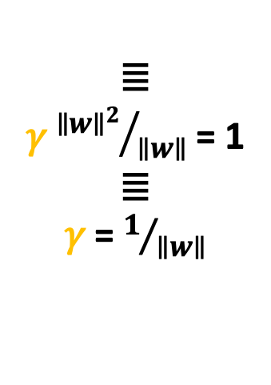
The Objective of SVM
How can we solve this problem?
  By normalizing the weight vector w (i.e., $w/{∥w∥}$), thus making it a unit vector
Regrouping terms, we see:
x¹
x¹ = x² + 2𝛾 $w/{∥w∥}$
≣
w.(x² + 2𝛾 $w/{∥w∥}$) + b = 1
≣
w.x² + b + 2𝛾 ${w.w}/{∥w∥}$ = 1
x²
𝛾
≣
𝛾 ${∥w∥^{2}}/{∥w∥}$ = 1
≣
𝛾 = $1/{∥w∥}$
w.x + b = +1
𝛾
w.x + b = -1
w.x + b = 0

Slide 38
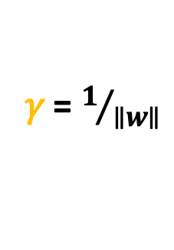
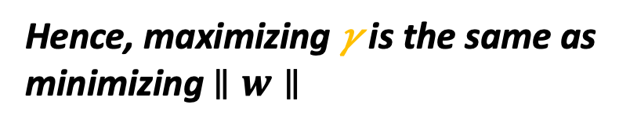
The Objective of SVM
How can we solve this problem?
  By normalizing the weight vector w (i.e., $w/{∥w∥}$), thus making it a unit vector
Regrouping terms, we see:
x¹
𝛾 = $1/{∥w∥}$
x²
Hence, maximizing 𝛾 is the same as
minimizing $∥w∥$
𝛾
w.x + b = +1
𝛾
w.x + b = -1
w.x + b = 0

Slide 39
The Objective of SVM
More formally, the goal of any SVM can be stated as follows:
Given a training set (x¹, y¹), (x², y²), . . . , (x^{n}, y^{n}), maximize 𝛾 (by varying w and b) subject to the constraint that for all i = 1, 2, . . . , n,
w.x^{i}+b ≥ 𝛾 if y^{i} = +1
w.x^{i} + b ≤ 𝛾 if y^{i} = −1

Slide 40
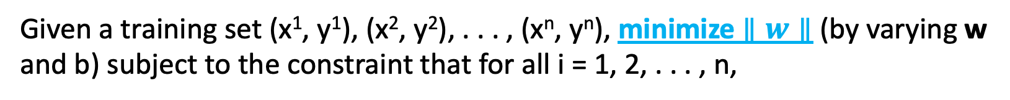
The Objective of SVM
More formally, the goal of any SVM can be stated as follows:
Given a training set (x¹, y¹), (x², y²), . . . , (x^{n}, y^{n}), minimize $∥w∥$ (by varying w and b) subject to the constraint that for all i = 1, 2, . . . , n,
w.x^{i}+b ≥ 1 if y^{i} = +1
w.x^{i} + b ≤ -1 if y^{i} = −1
But, why would this constraint
serve in materializing large
margin classification?

Slide 41
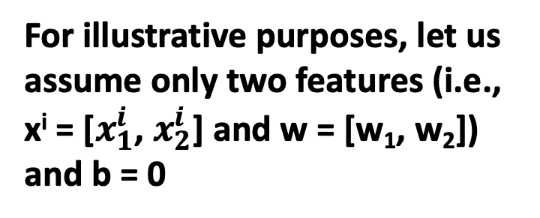
The Objective of SVM
More formally, the goal of any SVM can be stated as follows:
Given a training set (x¹, y¹), (x², y²), . . . , (x^{n}, y^{n}), minimize $∥w∥$ (by varying w and b) subject to the constraint that for all i = 1, 2, . . . , n,
For illustrative purposes, let us
assume only two features (i.e.,
x^{i} = [$x_{1}^{i}$, $x_{2}^{i}$] and w = [w₁, w₂])
and b = 0
w.x^{i}+b ≥ 1 if y^{i} = +1
w.x^{i} + b ≤ -1 if y^{i} = −1

Slide 42



The Objective of SVM
More formally, the goal of any SVM can be stated as follows:
Given a training set (x¹, y¹), (x², y²), . . . , (x^{n}, y^{n}), minimize $∥w∥$ (by varying w and b) subject to the constraint that for all i = 1, 2, . . . , n,
What is the inner product
of w and x^{i} (i.e., w.x^{i})?
w.x^{i} ≥ 1 if y^{i} = +1
w.x^{i} ≤ -1 if y^{i} = −1
$$x_{2}^{i}$$
$$x_{}^{i}$$
w
w₂
$$x_{1}^{i}$$
w₁

Slide 43


The Objective of SVM
More formally, the goal of any SVM can be stated as follows:
Given a training set (x¹, y¹), (x², y²), . . . , (x^{n}, y^{n}), minimize $∥w∥$ (by varying w and b) subject to the constraint that for all i = 1, 2, . . . , n,
What is the inner product
of w and x^{i} (i.e., w.x^{i})?
w.x^{i} ≥ 1 if y^{i} = +1
w.x^{i} ≤ -1 if y^{i} = −1
$$x_{}^{i}$$
Project x^{i} onto w
w
p^{i}. $∥w∥$
p^{i}
= w₁.$x_{1}^{i}$ + w₂.$x_{2}^{i}$

Slide 44
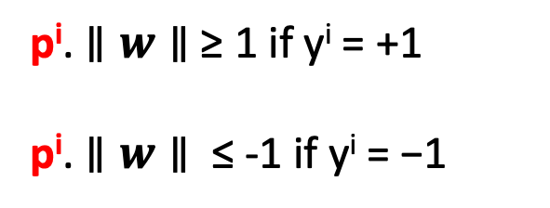
The Objective of SVM
More formally, the goal of any SVM can be stated as follows:
Given a training set (x¹, y¹), (x², y²), . . . , (x^{n}, y^{n}), minimize $∥w∥$ (by varying w and b) subject to the constraint that for all i = 1, 2, . . . , n,
What is the inner product
of w and x^{i} (i.e., w.x^{i})?
p^{i}. $∥w∥$ ≥ 1 if y^{i} = +1
p^{i}. $∥w∥$ ≤ -1 if y^{i} = −1
$$x_{}^{i}$$
Project x^{i} onto w
w
p^{i}. $∥w∥$
p^{i}
= w₁.$x_{1}^{i}$ + w₂.$x_{2}^{i}$

Slide 45

The Objective of SVM
More formally, the goal of any SVM can be stated as follows:
Given a training set (x¹, y¹), (x², y²), . . . , (x^{n}, y^{n}), minimize $∥w∥$ (by varying w and b) subject to the constraint that for all i = 1, 2, . . . , n,
If SVM encounters this green
decision boundary, will it choose it?
p^{i}. $∥w∥$ ≥ 1 if y^{i} = +1
p^{i}. $∥w∥$ ≤ -1 if y^{i} = −1
w
p¹
$$x_{}^{1}$$
Project x¹ onto w
w.x = 0

Slide 46


The Objective of SVM
More formally, the goal of any SVM can be stated as follows:
Given a training set (x¹, y¹), (x², y²), . . . , (x^{n}, y^{n}), minimize $∥w∥$ (by varying w and b) subject to the constraint that for all i = 1, 2, . . . , n,
If SVM encounters this green
decision boundary, will it choose it?
p^{i}. $∥w∥$ ≥ 1 if y^{i} = +1
p^{i}. $∥w∥$ ≤ -1 if y^{i} = −1
w
$$x_{}^{2}$$
p¹
p¹ is positive and very small, hence,
for p¹. $∥w∥$ to be ≥ 1, $∥w∥$ has to
be very large!
p²
$$x_{}^{1}$$
w.x = 0

Slide 47
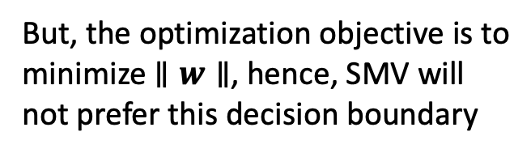
The Objective of SVM
More formally, the goal of any SVM can be stated as follows:
Given a training set (x¹, y¹), (x², y²), . . . , (x^{n}, y^{n}), minimize $∥w∥$ (by varying w and b) subject to the constraint that for all i = 1, 2, . . . , n,
If SVM encounters this green
decision boundary, will it choose it?
p^{i}. $∥w∥$ ≥ 1 if y^{i} = +1
p^{i}. $∥w∥$ ≤ -1 if y^{i} = −1
w
$$x_{}^{2}$$
p¹
But, the optimization objective is to
minimize $∥w∥$, hence, SMV will
not prefer this decision boundary
p²
$$x_{}^{1}$$
w.x = 0

Slide 48

The Objective of SVM
More formally, the goal of any SVM can be stated as follows:
Given a training set (x¹, y¹), (x², y²), . . . , (x^{n}, y^{n}), minimize $∥w∥$ (by varying w and b) subject to the constraint that for all i = 1, 2, . . . , n,
If SVM encounters this green
decision boundary, will it choose it?
p^{i}. $∥w∥$ ≥ 1 if y^{i} = +1
p^{i}. $∥w∥$ ≤ -1 if y^{i} = −1
w
$$x_{}^{2}$$
p¹
p² is negative and very small, hence,
for p². $∥w∥$ to be ≤ -1, $∥w∥$ has to
be very large!
p²
$$x_{}^{1}$$
w.x = 0

Slide 49
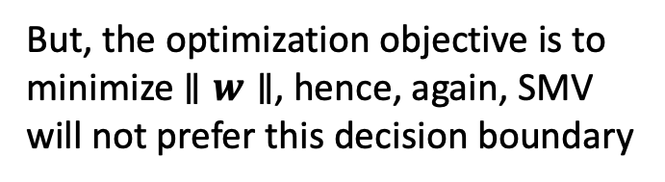
The Objective of SVM
More formally, the goal of any SVM can be stated as follows:
Given a training set (x¹, y¹), (x², y²), . . . , (x^{n}, y^{n}), minimize $∥w∥$ (by varying w and b) subject to the constraint that for all i = 1, 2, . . . , n,
If SVM encounters this green
decision boundary, will it choose it?
p^{i}. $∥w∥$ ≥ 1 if y^{i} = +1
p^{i}. $∥w∥$ ≤ -1 if y^{i} = −1
w
$$x_{}^{2}$$
p¹
But, the optimization objective is to
minimize $∥w∥$, hence, again, SMV
will not prefer this decision boundary
p²
$$x_{}^{1}$$
w.x = 0

Slide 50
The Objective of SVM
More formally, the goal of any SVM can be stated as follows:
Given a training set (x¹, y¹), (x², y²), . . . , (x^{n}, y^{n}), minimize $∥w∥$ (by varying w and b) subject to the constraint that for all i = 1, 2, . . . , n,
If SVM encounters this green
decision boundary, will it choose it?
p^{i}. $∥w∥$ ≥ 1 if y^{i} = +1
p^{i}. $∥w∥$ ≤ -1 if y^{i} = −1
w
NO
$$x_{}^{2}$$
p¹
p²
$$x_{}^{1}$$
w.x = 0

Slide 51

The Objective of SVM
More formally, the goal of any SVM can be stated as follows:
Given a training set (x¹, y¹), (x², y²), . . . , (x^{n}, y^{n}), minimize $∥w∥$ (by varying w and b) subject to the constraint that for all i = 1, 2, . . . , n,
If SVM encounters this purple
decision boundary, will it choose it?
p^{i}. $∥w∥$ ≥ 1 if y^{i} = +1
p^{i}. $∥w∥$ ≤ -1 if y^{i} = −1
$$x_{}^{2}$$
p¹
p¹ is positive and bigger now, hence,
for p¹. $∥w∥$ to be ≥ 1, $∥w∥$ can be
smaller, aligning better with the
optimization objective
p²
w
$$x_{}^{1}$$
w.x = 0

Slide 52

The Objective of SVM
More formally, the goal of any SVM can be stated as follows:
Given a training set (x¹, y¹), (x², y²), . . . , (x^{n}, y^{n}), minimize $∥w∥$ (by varying w and b) subject to the constraint that for all i = 1, 2, . . . , n,
If SVM encounters this purple
decision boundary, will it choose it?
p^{i}. $∥w∥$ ≥ 1 if y^{i} = +1
p^{i}. $∥w∥$ ≤ -1 if y^{i} = −1
$$x_{}^{2}$$
p¹
p² is negative and bigger now, hence,
for p². $∥w∥$ to be ≤ -1, $∥w∥$ can be
smaller, aligning better with the
optimization objective
p²
w
$$x_{}^{1}$$
w.x = 0

Slide 53
The Objective of SVM
More formally, the goal of any SVM can be stated as follows:
Given a training set (x¹, y¹), (x², y²), . . . , (x^{n}, y^{n}), minimize $∥w∥$ (by varying w and b) subject to the constraint that for all i = 1, 2, . . . , n,
If SVM encounters this purple
decision boundary, will it choose it?
p^{i}. $∥w∥$ ≥ 1 if y^{i} = +1
p^{i}. $∥w∥$ ≤ -1 if y^{i} = −1
YES
$$x_{}^{2}$$
𝛾
p¹
p²
𝛾
w
$$x_{}^{1}$$
w.x = +1
w.x = -1
w.x = 0

Slide 54

Example
Consider the following training examples, assuming w = [u, v] and 𝛾 = 1
  Our goal is to minimize $\sqrt{u^{2}+v^{2}}$subject to the constraints y_{i}(w.x_{i} + b) ≥ 𝛾, which can be derived from the training examples
x | y | Constraints
[1, 2] | +1 | (+1)(u + 2v + b) = u + 2v + b ≥ 1
[2, 1] | -1 | 2u + v + b ≤ −1
[3, 4] | +1 | 3u + 4v + b ≥ 1
[4, 3] | -1 | 4u + 3v + b ≤ −1
x | y | Constraints
[1, 2] | +1 | (+1)(u + 2v + b) = u + 2v + b ≥ 1
[2, 1] | -1 | 2u + v + b ≤ −1
[3, 4] | +1 | 3u + 4v + b ≥ 1
[4, 3] | -1 | 4u + 3v + b ≤ −1
x | y | Constraints
[1, 2] | +1 | (+1)(u + 2v + b) = u + 2v + b ≥ 1
[2, 1] | -1 | 2u + v + b ≤ −1
[3, 4] | +1 | 3u + 4v + b ≥ 1
[4, 3] | -1 | 4u + 3v + b ≤ −1
How to solve for u, v, and b?

Slide 55
Example
Consider the following training examples, assuming w = [u, v] and 𝛾 = 1
  Our goal is to minimize $\sqrt{u^{2}+v^{2}}$subject to the constraints y_{i}(w.x_{i} + b) ≥ 𝛾, which can be derived from the training examples
x | y | Constraints
[1, 2] | +1 | (+1)(u + 2v + b) = u + 2v + b ≥ 1
[2, 1] | -1 | 2u + v + b ≤ −1
[3, 4] | +1 | 3u + 4v + b ≥ 1
[4, 3] | -1 | 4u + 3v + b ≤ −1
x | y | Constraints
[1, 2] | +1 | (+1)(u + 2v + b) = u + 2v + b ≥ 1
[2, 1] | -1 | 2u + v + b ≤ −1
[3, 4] | +1 | 3u + 4v + b ≥ 1
[4, 3] | -1 | 4u + 3v + b ≤ −1
x | y | Constraints
[1, 2] | +1 | (+1)(u + 2v + b) = u + 2v + b ≥ 1
[2, 1] | -1 | 2u + v + b ≤ −1
[3, 4] | +1 | 3u + 4v + b ≥ 1
[4, 3] | -1 | 4u + 3v + b ≤ −1
In this very simple case, it is easy to see that b = 0 and w [-1, +1]

Slide 56
Example
Consider the following training examples, assuming w = [u, v] and 𝛾 = 1
  Our goal is to minimize $\sqrt{u^{2}+v^{2}}$subject to the constraints y_{i}(w.x_{i} + b) ≥ 𝛾, which can be derived from the training examples
x | y | Constraints
[1, 2] | +1 | (+1)(u + 2v + b) = u + 2v + b ≥ 1
[2, 1] | -1 | 2u + v + b ≤ −1
[3, 4] | +1 | 3u + 4v + b ≥ 1
[4, 3] | -1 | 4u + 3v + b ≤ −1
In general, we can use gradient descent!

Slide 57
Next Wednesday’s Lecture…
SVM
Motivation
Background
Objective
Algorithm

